Slide 1

DROWNING AND ITS MANAGEMENT
S. BALARAM
CRMI

Slide 2
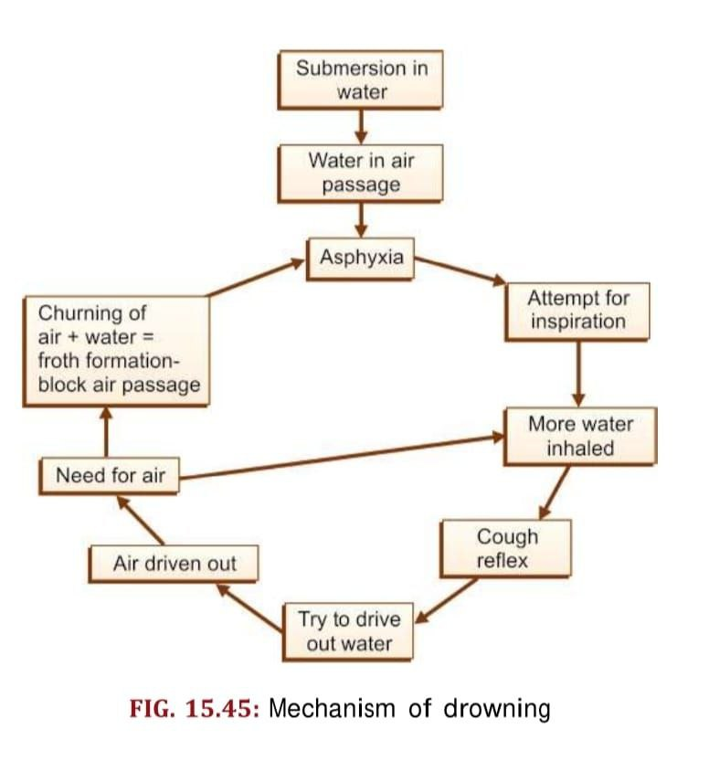
INTRODUCTION:
WHO definition: Process of respiratory impairment due to submersion (complete/incomplete) or immersion in water
Causes of drowning:
Accidental (most common cause)
Exhaustion
Hypothermia
Entrapment in whirlpool/tidal waves
Types of drowning:
Typical drowning (Wet drowning)
Atypical drowning (Dry drowning)
Shallow water drowning
Immersion syndrome/ hydrocution
Secondary drowning/ near drowning

Slide 3
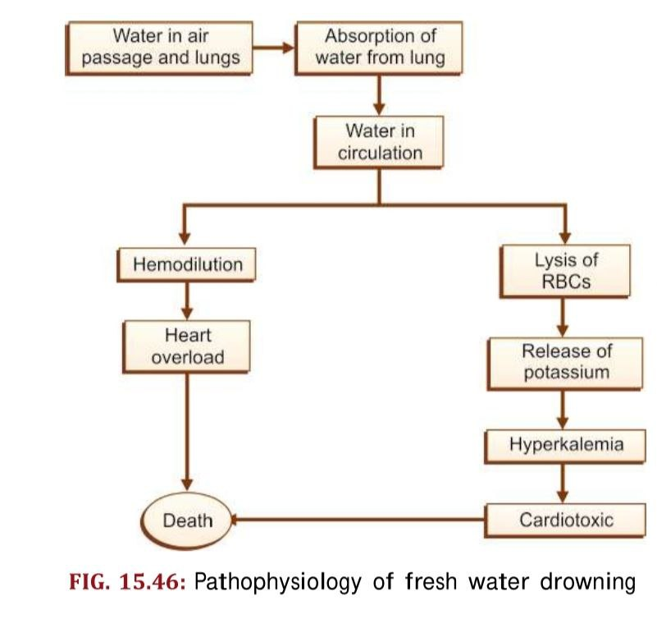
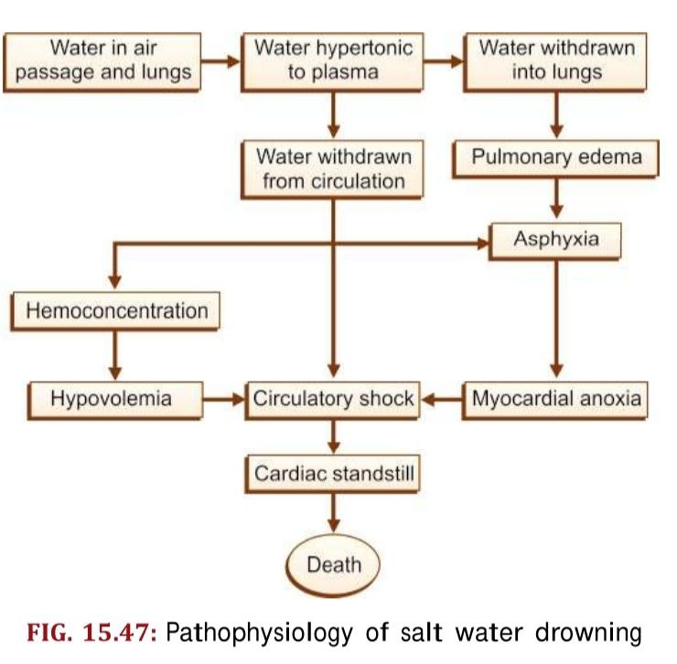
WET DROWNING ( TYPICAL DROWNING):
It is a condition in which the obstruction of air passages and lungs by fluids
Here, victim has severe chest pain, and death occurs due to cardiac arrest or ventricular fibrillation
Wet drowning includes fresh water and salt water drowning
ATYPICAL DROWNING:
It is a condition in which there is very little or no inhalation of water in air passage and includes:

Slide 4
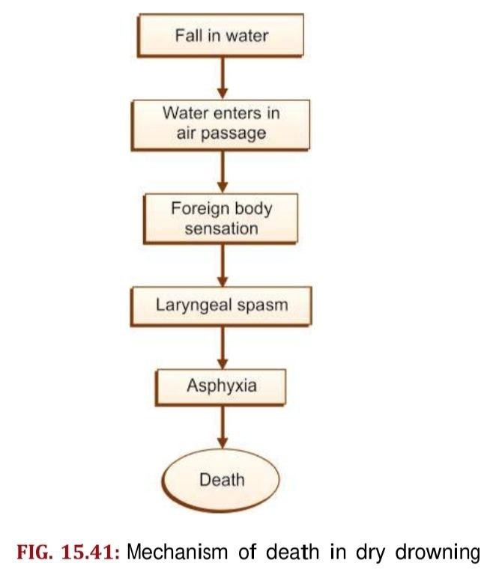
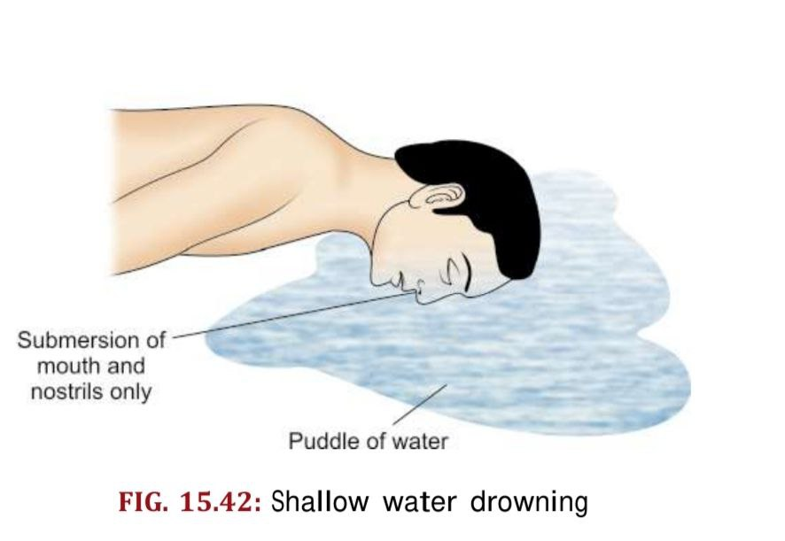
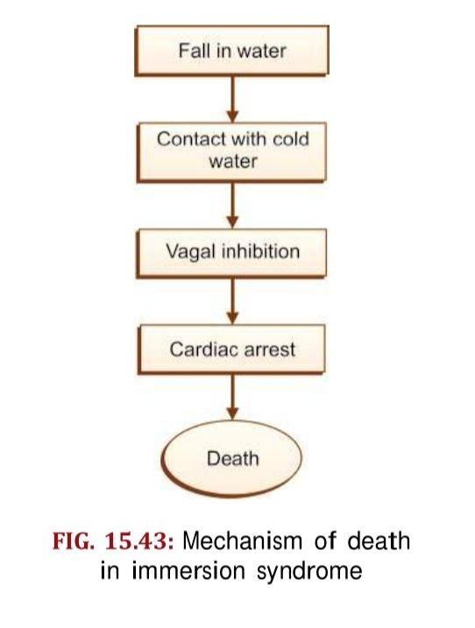
DRY DROWNING:
In this condition, no or little water is inhaled
in respiratory tract. Here death occurs due to
laryngeal spasm
Clinical features: coughing, difficulty breathing, confusion
sleepiness, fast or hard breathing.
SHALLOW WATER DROWNING:
In this condition, drowning occurs in small puddle of
water when depth of water is only few inches but
sufficient to submerge the mouth and nostrils. It
is mostly accidental in those persons who are disabled
or small children, epileptics, drunkards
IMMERSION SYNDROME/ HYDROCUTION:
Sudden contact of cold water with body surface leads
to stimulation of nerve endings and causes vagal inhibition
and leads to death of person due to cardiac arrest.

Slide 5
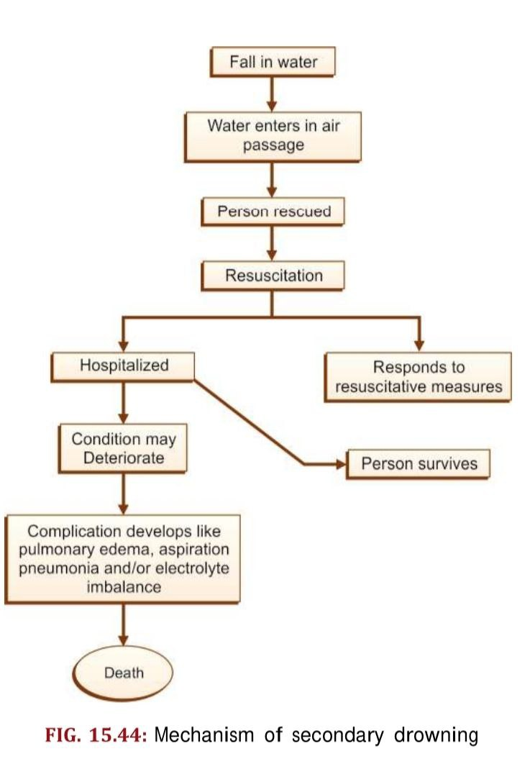
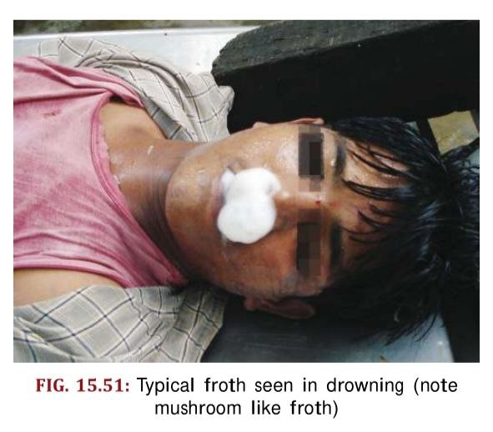
SECONDARY DROWNING/ NEAR DROWNING:
It refers to a condition in which there is survival of
person following immersion episode and the victim die
subsequently as a result of pathophysiological
consequences. Death occurs as a sole or combine
effect of pulmonary edema, aspiration pneumonia and
electrolye imbalance.
CAUSES OF DEATH:
Asphyxia
Vagal inhibition
Ventricular fibrillation
Myocardial anoxia
Laryngeal spasm
Exhaustion
Hypothermia
Head injury
SIGNS AND SYMPTOMS:
Cyanosis, coughing and production of frothy white sputum
Tachypnea, tachycardia
Low grade fever
Rales, rhonchi
Signs of associated head and neck trauma
Coma to aggitated alert

Slide 6
EFFECTS OF DROWNING
Pulmonary :
• Aspirated water washes out surfactant causing acute respiratory distress syndrome
• Decreased lung compliance
• Ventilation–perfusion mismatching
• Chest X-ray can be normal, localized, perihilar or diffuse pulmonary edema.
Neurological:
• Hypoxic neuronal damage
• Cerebral edema/raised ICT
Cardiovascular:
• Arrhythmias can be secondary to hypothermia or hypoxia.
• Most common include sinus tachycardia, sinus bradycardia, atrial fibrillation
Renal:
• Hypoxic acute tubular necrosis can occur in near fatal drowning.

Slide 7
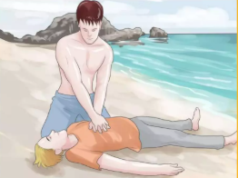
DIAGNOSTIC TESTS FOR DROWNING:
Chest XRAY: Helps to visualize the extent of lung damage such as edema or fluid accumulation
Blood tests: It helps to assess elctrolytes imbalances, blood glucose levels and rule out other conditions contributing to drowning
ECG: It helps in evaluate for heart arrythmias or other cardiac issues which can contribuite for drowning
Diatom test( Foresnsic cases): In forensic investigations, diatoms found in organs can help support the diagnosis of drowning if the victim aspirated water.
FIRST AID MANAGEMENT FOR DROWNING:
1. Scene safety:
Make sure the scene is safe for victim and rescuer.
2. Rescue the victim to land:
Call- Call the nearby person for help
Reach- Try to reach the victim
Throw and tow- Throw- rope, life rings, floating
rings to the victim

Slide 8
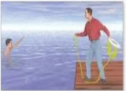
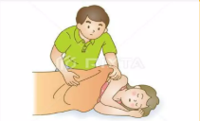
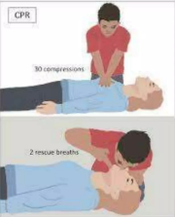
Row- Row the victim if possible
Go- Go yourself to rescue the victim if possible
3. Position:
Position the victim on their back first (Supine).
4. Activate the medical emergency system:
Inform the medical emergency unit through phone
5. Observe:
Obseve a patient if he/she is conscious:
Warm the victim by covering with blanket
Provide recovery position and shift the patient to hospital.
If the victim is unconscious and unresponsive with
no breathing and pulse:
Start CPR
Reassess the condition every 2 minutes and shift the victim
to hospital.

Slide 9
HOSPITAL EMERGENCY MANAGEMENT:
Trauma assessment to look for other injuries (including cervical spine injuries)
Wet clothes should be removed and warming blankets should be applied
NEUROLOGICAL INJURIES:
Main goal is to prevent secondary neurological injuries due to ischemia, cerebral edema, hypotension, electrolye imbalance
Elevation of head end at 30 degrees
Diuretics to decrease cerebral edema, titrated so as to not cause hypotension
Prevent seizure by using non sedative antiepileptics like phenytoin
Avoid neuromuscular blockers
Prevent hypo and hyperglycemia and maintain sugar level of 180-200mg/dl.
Hyperventilation can be tried in patients with imminent threat of herniation. Prolonged hyperventilation should be avoided as it causes vasoconstriction and decreased cerebral blood flow.

Slide 10
2. RESPIRATORY:
Bronchospasm is common and should be treated with nebulization.
Antibiotics are indicated in case chest X-ray shows features of consolidation.
Pseudomonas should be covered in this case.
Mechanical ventilation if indicated:
If SPO2 is <90 or pO2 is <60 on high flow oxygen.
Drowsy patient.
In patients on non-invasive ventilation, saturation is to be maintained above 94%
ECMO has been tried in a few case series but there is not too much evidence supporting its use.
Use of exogenous surfactant: Has been tried.

Slide 11
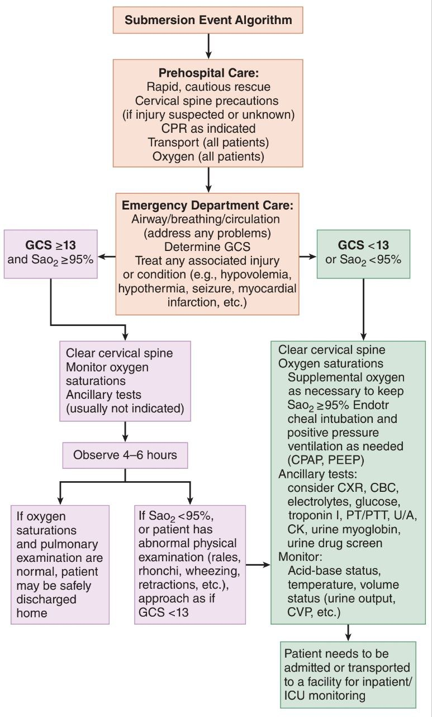
Drowning algorithm

Slide 12
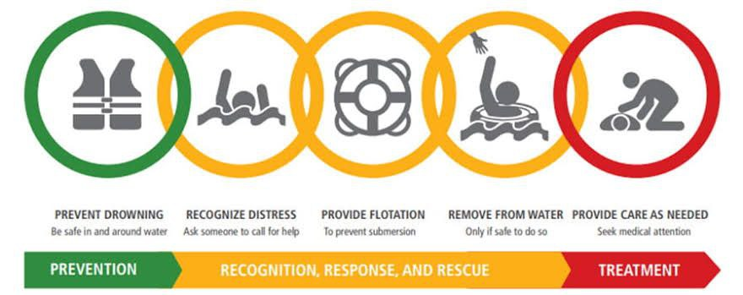
POOR PROGNOSIS IN DROWNING:
• Duration of submersion >5 minutes (most critical factor)
• Time to effective basic life support >10 minutes
• Resuscitation duration >25 minutes
• Age >14 years
• Glasgow Coma Scale <5 (i.e. comatose)
• Persistent apnea and requirement of cardiopulmonary resuscitation in the emergency department
• Arterial blood pH <7.1 upon presentation

Slide 13


